Slide 1
EGRS Synthesis Report
EGRS Synthesis Report
Stephen Taylor
South African Department of Basic Education
3 July 2025

Slide 2
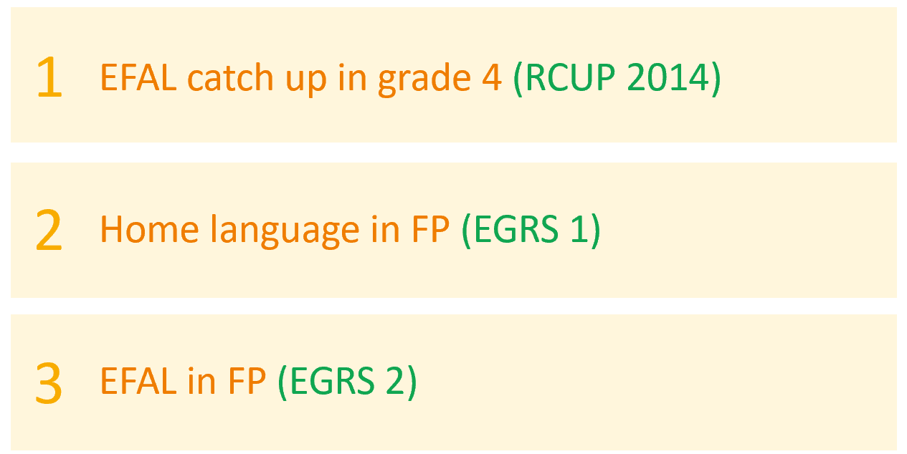
Background: The literacy challenge in SA

Slide 3
Background: The literacy challenge in SA

Slide 4
Background: The literacy challenge in SA

Slide 5
Background: The literacy challenge in SA

Slide 6
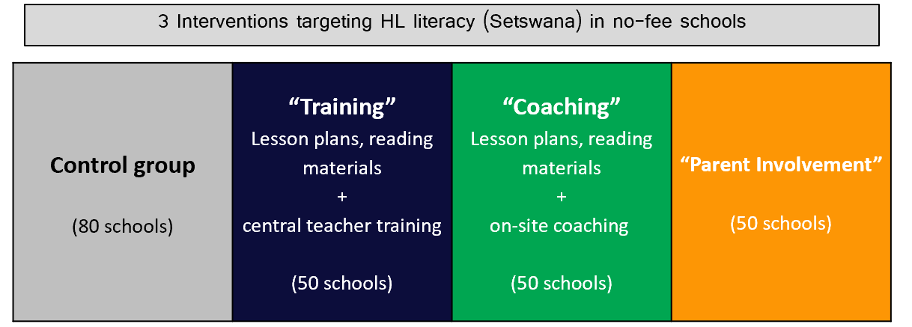
Early Grade Reading Study 1

Slide 7
Can the impact of coaching be achieved in ways are more “scaleable”?
Virtual Coaching?
Internal coaching by School Head of Department?

Slide 8
Challenges and Opportunities of Scaling - DH Coaching can work if….

Slide 9
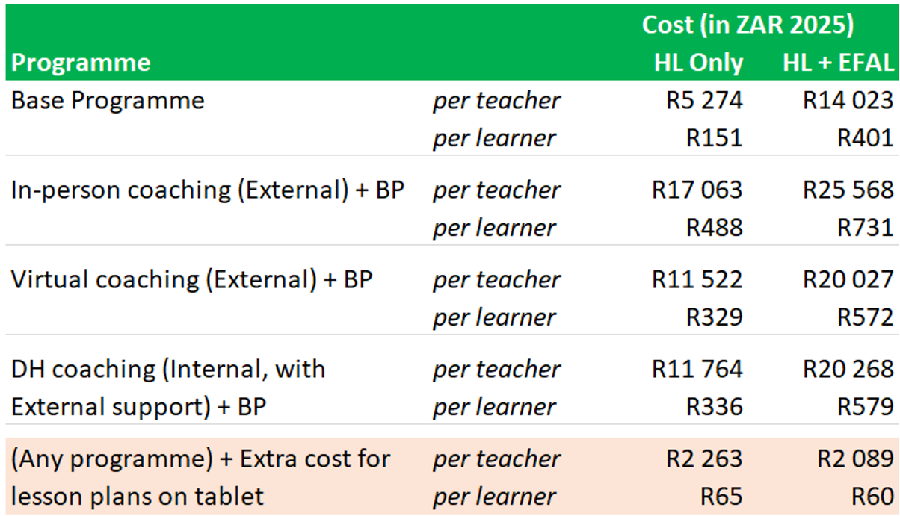
Costing

Slide 10
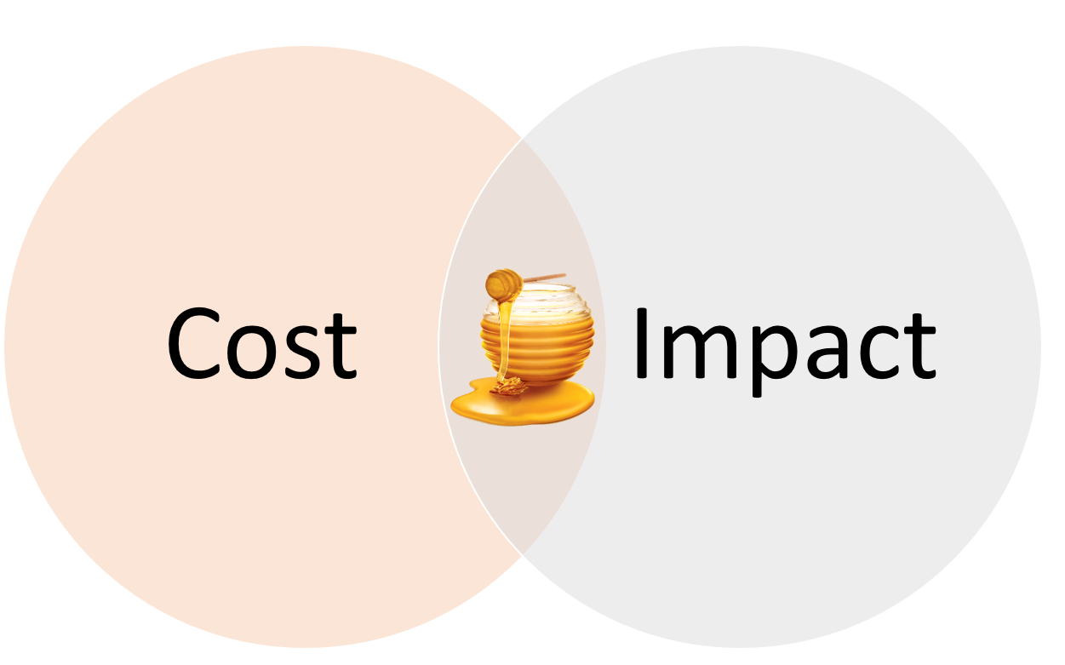
Costing

Slide 11
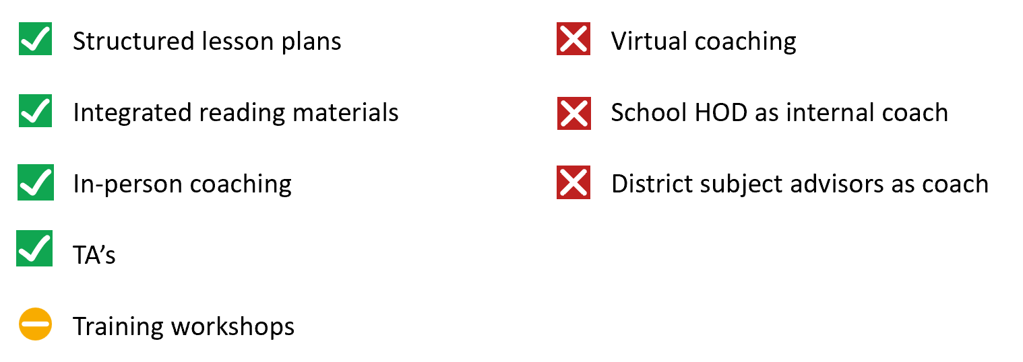
Implementation modalities

Slide 12
Long run impacts
On Learners
Impact on grade 7 comprehension in both HL and EFAL
Increased likelihood of reaching grade 9 without repeating
On Teachers
Impact on next cohort of learners (half as large)

Slide 13
Language and language transitions
Positive spillover from HL to ENG
No spillover from EFAL to HL

Slide 14
Mapping EGRS to WWH Framework

Slide 15
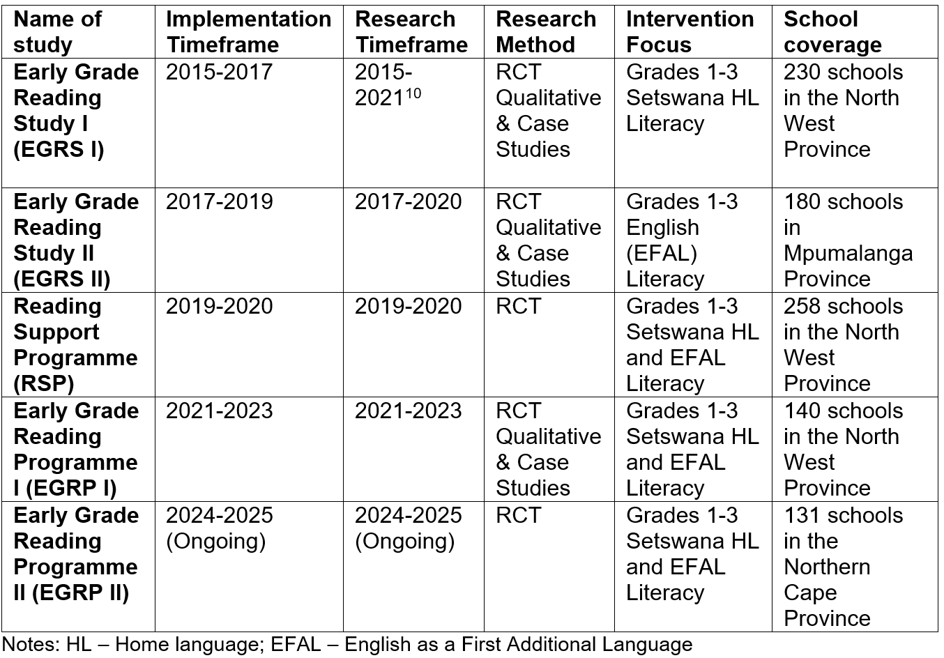
Overview of the studies in the EGRS Series

Slide 16
Thank you

